Slide 1
Cognitive correlates of First-Person Shooter gaming: A cross-sectional study of Counter-Strike players
Eleanor R. A. Hyde, Robert Schmidt, Daniel J. Carroll and Claudia C. von Bastian
31/10/2024
ERC 2024

Slide 2






Cognition: mental processes
Cognitive Correlates
Cognitive Plasticity

Slide 3

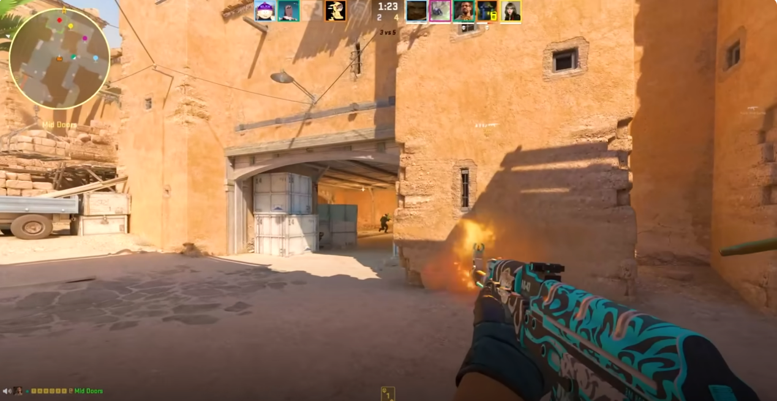


Cognitively challenging leisure activities
Cognitive plasticity can be enhanced through engagement in cognitively challenging leisure activities (von Bastian, Hyde & Jiang, 2023)

Slide 4



Previous Methodological Limitations
Research shows mixed findings for the cognitive correlates of FPS gameplay:
Broad definitions of video games
Small samples of novice players
Limited assessment of video game skill

Slide 5


Cognitive Task
Choice Reaction Time Task
Blue or Green

Slide 6


Cognitive Task
Choice Reaction Time Task
Curvy or Spiky

Slide 7
Reaction Times (RTs)
Processing Speed: general ability to process information
Task Mixing: ability to conduct two or more tasks in close succession
Task Switching: ability to switch from one task to another

Slide 8

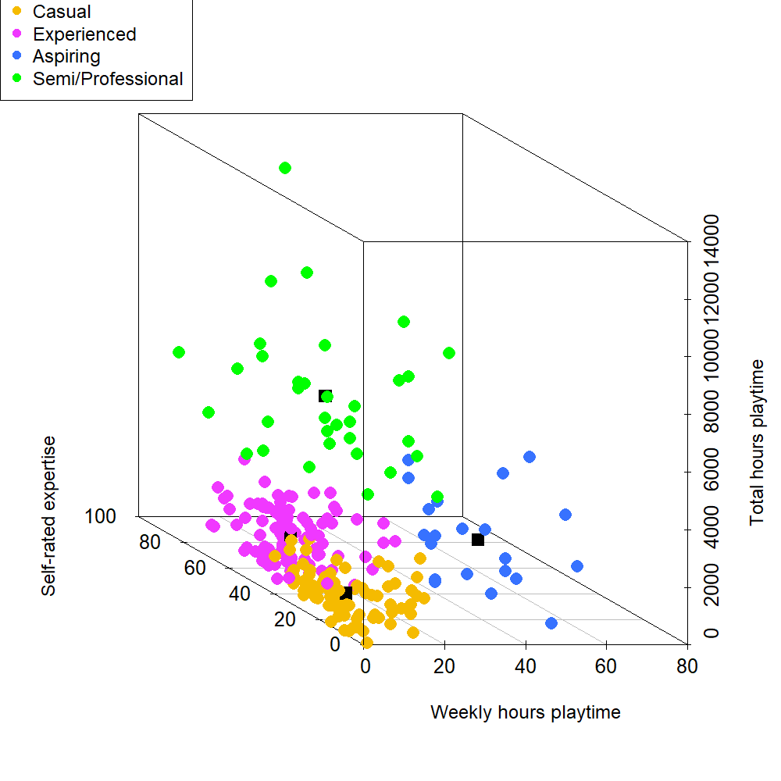
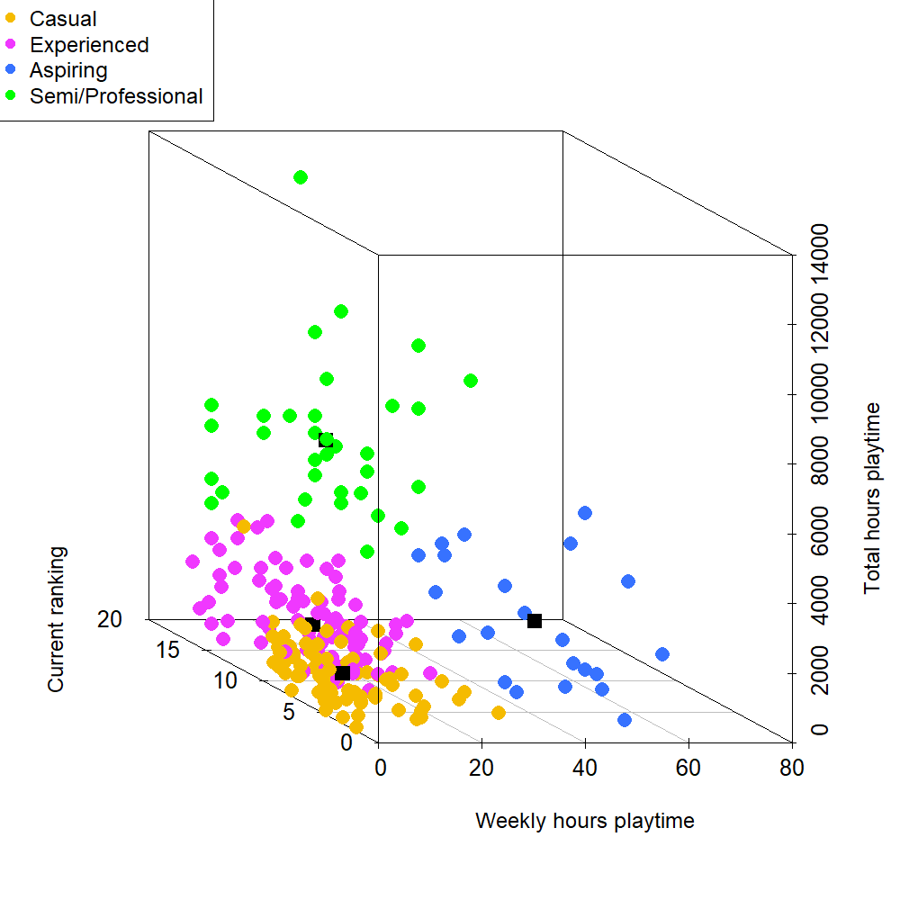
Counter-Strike Skill
Four measures K-means cluster analysis
Semi/Professional (n = 34)
Aspiring (n = 22)
Experienced (n = 101)
Novice (n = 78)
N = 235
Total Hours
Total Hours
Self-Rated Skill
Current Ranking
Weekly Hours
Weekly Hours

Slide 9
Processing Speed
Evidence of an effect of expertise group on single and switching RTs
M = 591, SD = 112

Slide 10

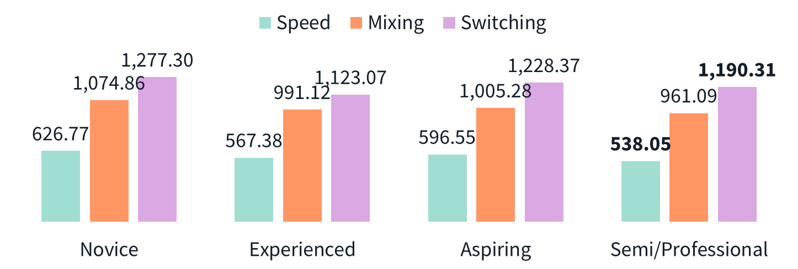
The Drift-Diffusion Model
1. Drift Rate (v) information accumulation
2. Boundary Separation (a) response caution
3. Non-decision time (t0) other non-decisional processes
Drift Rate (v)
Boundary Separation (a)
Green
Blue
Encoding
Decision Time
Response Execution
Non-decision time (t0)

Slide 11

The Drift-Diffusion Model
Evidence of an effect of expertise group on switching drift rate, speed boundary separation and speed non-decision time
M = 591, SD = 112

Slide 12
Summary
Semi/Professional players demonstrated faster processing speed in single trials
Experienced players showed advantages in processing speed for switch trials
Semi/Professional players showed faster non-decision times in single trials and higher drift rates in switch trials, but greater boundary separations in single trials

Slide 13
Take-home message
More skilled Counter-Strike players demonstrate enhanced decision-making ability in both stable and dynamic cognitive tasks
Performance advantages go beyond simple reaction times, reflecting sophisticated decisional strategies
Suggesting an association with FPS skill and greater cognitive efficiency (von Bastian et al., 2022)

Slide 14



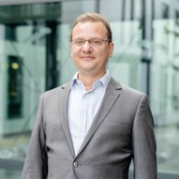


Thanks for listening!
erahyde1@sheffield.ac.uk
www.eleanorhyde.com
Dr Claudia von Bastian
The University of Sheffield
Dr Robert Schmidt
Ruhr-Universität Bochum
Dr Dan Carroll
The University of Sheffield
Endpoint

